Slide 1
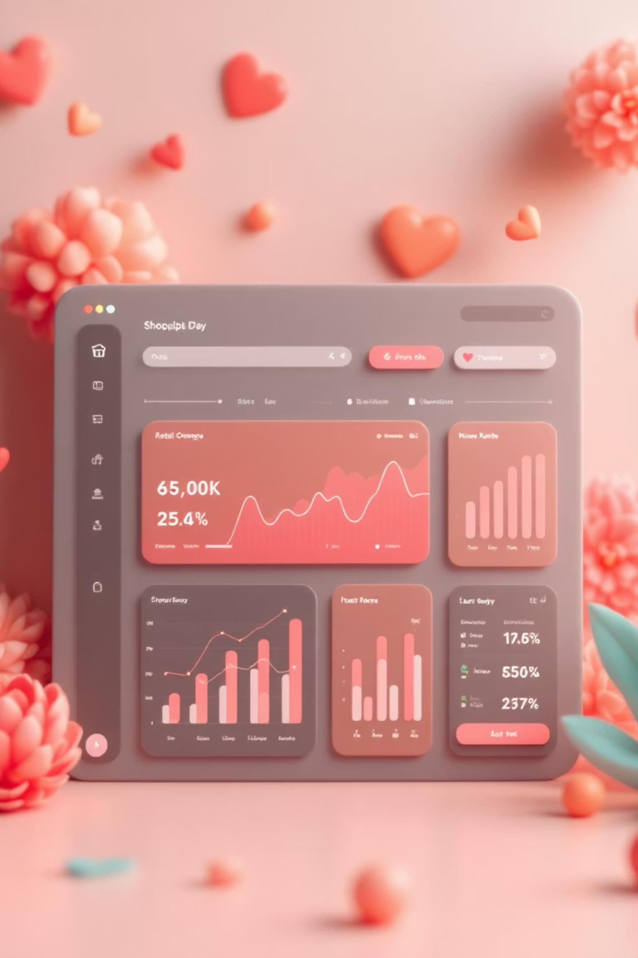
Customer Shopping Behaviour Analysis
Uncovering insights from 3,900 purchases to guide strategic business decisions

Slide 2


PROJECT OVERVIEW
Understanding Customer Patterns
Analyzing transactional data to uncover spending patterns, customer segments, and product preferences across various categories.
3,900
Total Purchases
Spending patterns and trends
Customer segmentation insights
18
Product preference analysis
Subscription behavior patterns
Data Features

Slide 3

DATASET
Data Foundation
Demographics
Purchase Details
Age, gender, location, subscription status
Item, category, amount, season, size, color
Shopping Behavior
Discounts, previous purchases, frequency, ratings, shipping

Slide 4
PYTHON ANALYSIS
Data Preparation & Cleaning
01
02
Data Loading
Initial Exploration
Imported dataset using pandas for analysis
Checked structure with df.isnull().sum() and df.describe()
03
04
Column Standardization
Feature Engineering
Renamed columns to lowercase for consistency
Created age_group and purchase_frequency columns
05
06
Data Consistency
Database Integration
Verified redundancy, dropped promo_code_used
Connected to MySQL and loaded cleaned data

Slide 5
MYSQL ANALYSIS
Key Business Questions
Revenue by Gender
Subscribers vs Non-subscribers
Male vs female spending comparison
Average spending and revenue analysis
High-Spending Discount Users
Top 5 Discount Purchases
Customers using discounts above average
Highest percentage with discounts
Top 5 Products by Rating
Customer Segmentation
Highest average review ratings
New, Returning, and Loyal classification
Shipping Type Comparison
Repeat Buyers & Subscriptions
Standard vs Express spending patterns
5+ purchases correlation with subscriptions
Revenue by Age Group
Total contribution per age segment

Slide 6



Customer Segmentation Insights
1
Loyal
2
Returning
3
New Customers
Classified customers based on purchase history to identify growth opportunities and retention strategies

Slide 7

Subscription Impact Analysis
Subscribers vs Non-subscribers
Comparing average spending and total revenue across subscription status reveals significant differences in customer value.
Customers with 5+ purchases show higher subscription likelihood, indicating strong correlation between repeat behavior and subscription adoption.

Slide 8
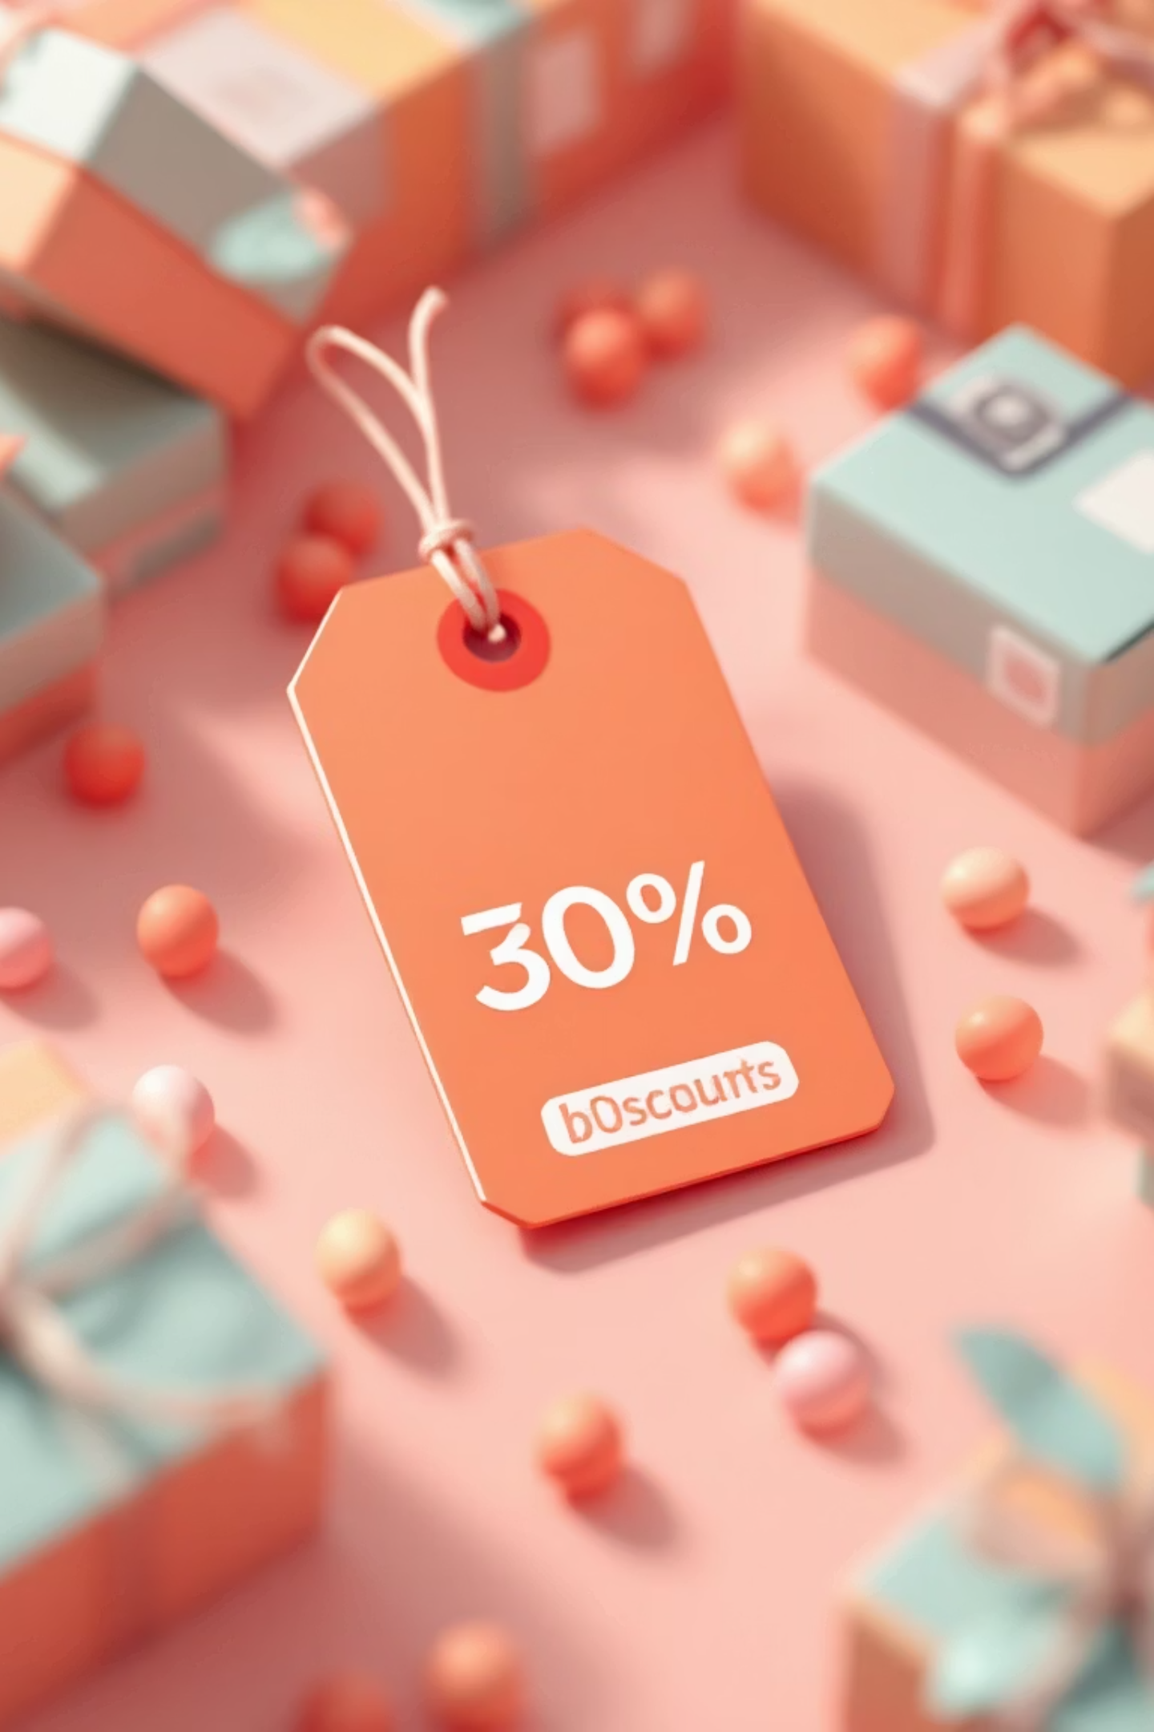
Discount & Shipping Patterns
High-Spending Discount Users
Shipping Type Preferences
Identified customers using discounts while maintaining above-average purchase amounts
Express shipping users show different spending patterns compared to Standard shipping customers
Top Discount Purchases
Analyzed highest percentage purchases with discount applied to understand promotion effectiveness

Slide 9





RECOMMENDATIONS
Strategic Business Actions
Boost Subscriptions
Promote exclusive benefits for subscribers
Customer Loyalty Programs
Reward repeat buyers to move them into Loyal segment
Review Discount Policy
Balance sales boosts with margin control
Product Positioning
Highlight top-rated and best-selling products in campaigns
Targeted Marketing
Focus on high-revenue age groups and express-shipping users

Slide 10

Key Takeaways
Data-Driven Insights
Customer Segmentation
3,900 purchases analyzed across 18 features
Clear patterns in New, Returning, and Loyal segments
Actionable Strategies
Five key recommendations to drive growth
Transform insights into action to maximize customer value and drive sustainable growth

